Slide 1


Precipitation Prediction based on NOAA JFK STATION University of Toronto – Data Analytics Project 4 Machine learning Group Member Names: Daniel Marquez Peiran (Diana) Cao Lailah Libay

Slide 2

About the project
Predictive precipitation modelling of weather patterns using NOAA station data (JFK)
Select monthly data from 2010-2022
Variables select wind, precipitation, temperature, pressure, fog, thunderstorms
Supervise Machine learning Model: Regression, linear model, means square
Visualization: Tableau
Notes:
Why we selected monthly data
Reduced dimensionality: Daily weather data can be quite granular and result in a large number of features. This high dimensionality can lead to increased complexity and computational requirements for training models. By aggregating the data into monthly intervals, you can significantly reduce the number of features, making it easier to analyze and model.
Smoothing and generalization: Daily weather data often includes fluctuations and noise due to short-term variations, such as daily weather patterns or measurement errors. Aggregating the data to a monthly level can help smooth out these fluctuations, providing a more generalized view of the weather patterns over time. This can improve the overall stability and robustness of your models.
Enhanced interpretability: Monthly data can offer a clearer understanding of long-term climate trends and patterns. By analyzing monthly weather data, you can identify seasonal variations, climate changes, or trends that may not be as evident in daily data. This can provide valuable insights and help make more informed decisions.
Data availability and consistency: In some cases, obtaining reliable and consistent daily weather data for a long period can be challenging. Quality control issues, missing data, or variations in data sources can introduce inconsistencies or gaps in the dataset. Monthly data, on the other hand, is generally more readily available and tends to have fewer data quality issues, making it easier to obtain and work with.
Computational efficiency: Working with monthly data reduces the computational burden associated with processing and analyzing large volumes of daily data. This can be particularly beneficial when working with limited computing resources or when dealing with large-scale datasets.

Slide 3




Slide 1
This Photo by Unknown Author is licensed under CC BY
ETL （Extract， Transform， Load)
EDA (Exploratory Data Analysis)
Visualizations
Machine Learning

Slide 4



ETL
Main Menu
Transform
LOAD
EXTRACT
Data Clean
Filter
Summarize
PostgreSQL
NOAA.GOV API

Slide 5

EDA (exploratory Data analysis)
Main Menu
Data Collection
Data Inspection
Data Visualization
Feature Analysis (Calculate correlation)
Missing Data Handling
Feature Engineering
Data Preprocessing
Outlier Detection
Dimensionality Reduction
Data Split
Notes:
Using PostgreSQL, Python, and NOAA API
Data Collection:
Retrieve weather data from NOAA API
Store data in PostgreSQL database
Data Inspection:
Connect to PostgreSQL database
Check data structure and quality
Data Visualization:
Use Python libraries for visualizations
Plot time series graphs, histograms, etc.
Feature Analysis:
Explore relationships between features
Calculate correlations with target variable
Missing Data Handling:
Determine strategy for missing values
Remove or impute missing data
Feature Engineering:
Create new features from existing ones
Consider temporal features, transformations
Data Preprocessing:
Scale, normalize, one-hot encode data
Prepare data for machine learning models
Outlier Detection:
Identify and handle outliers
Use statistical or visual techniques
Data Split:
Divide data into training, validation, test sets
Train, tune, and evaluate models

Slide 6
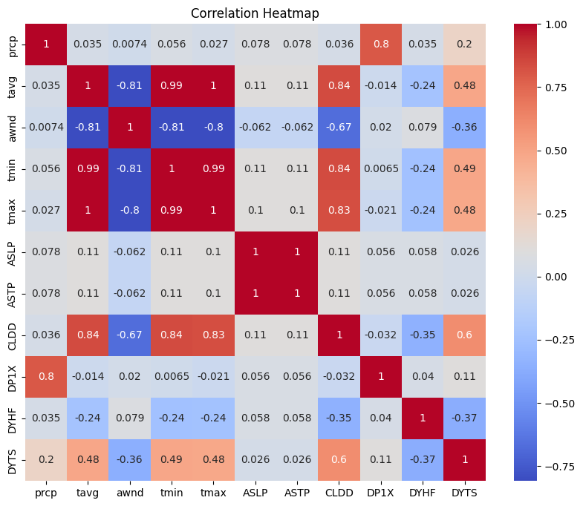
Feature Analysis (Calculate correlation)
Main Menu

Slide 7
Machine Learning: Process
Scikit-learn's train_test_split function
Scikit-learn's train_test_split function
Main Menu
Import
Import Dependencies for machine learning
Use
Use extracted data obtained in ETL
Utilize
Utilize dependent and independent variables selected in EDA
Scale
Scale Data
Assign
Assign Train & Test data using Scikit-learn’s train-test split function
Apply
Apply Supervised Learning Linear Regression models:
Linear_model
Ridge Regression
Lasso Regression
Elastic Net Regression
Print
Print R2 and mean-squared error scores
Identify
Identify the optimal Linear Regression model to use

Slide 8
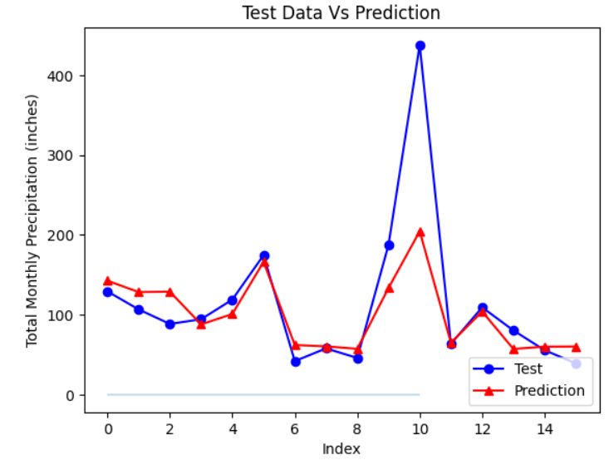
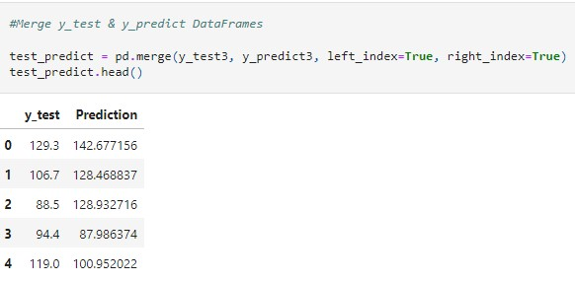
Machine Learning: Test VS Predicted Data
Main Menu

Slide 9
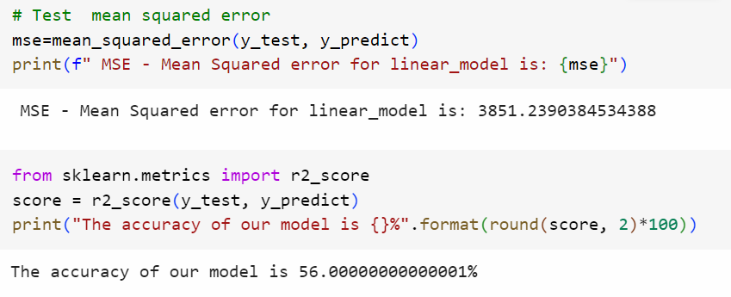
Machine Learning: MSE & R2 Scores
Main Menu

Slide 10
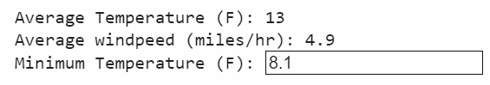
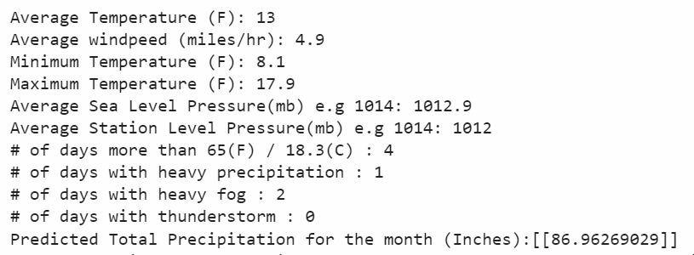
Machine Learning (Applying Prediction Model)
Main Menu
User Input Data
Predicted result

Slide 11
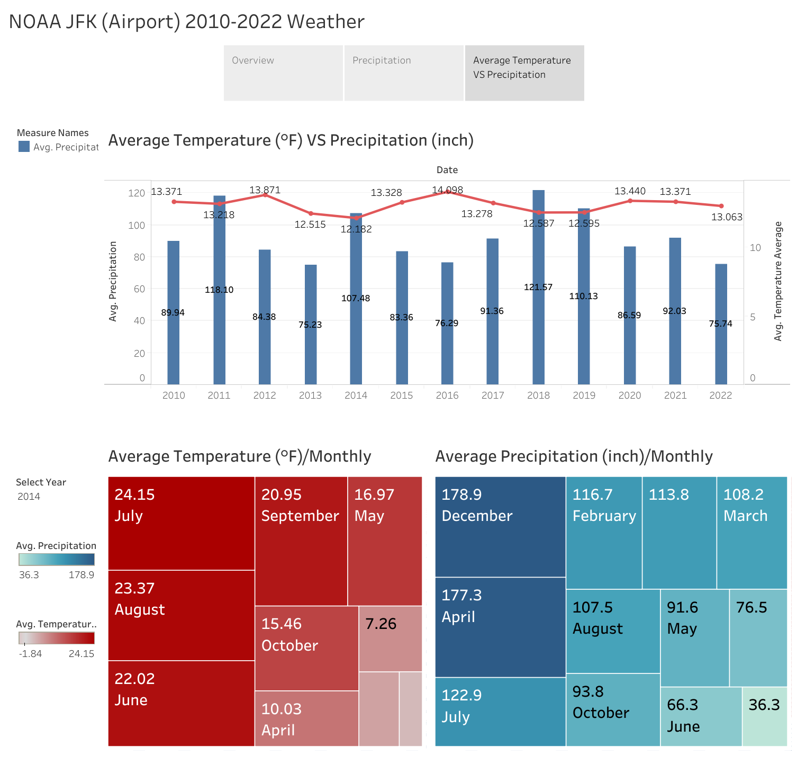
Visualizations Click Graphic to open Tableau
Main Menu

Slide 12

QUESTION TIME
Main Menu

Slide 13

Thank you
Main Menu

